Slide 1
SCUDEM-V-TEAM-1053-PROBLEM-C
BY: MAJ KEVIN QUIGLEY, ETHAN WOOD, NAKUL RAO

Slide 2
Road MAP
SOLUTION STRATEGY
VARIABLES AND FUNCTIONS
ASSUMPTIONS AND LIMITATIONS
WAYS TO EXTEND THE PROJECT
CONCLUSION

Slide 3

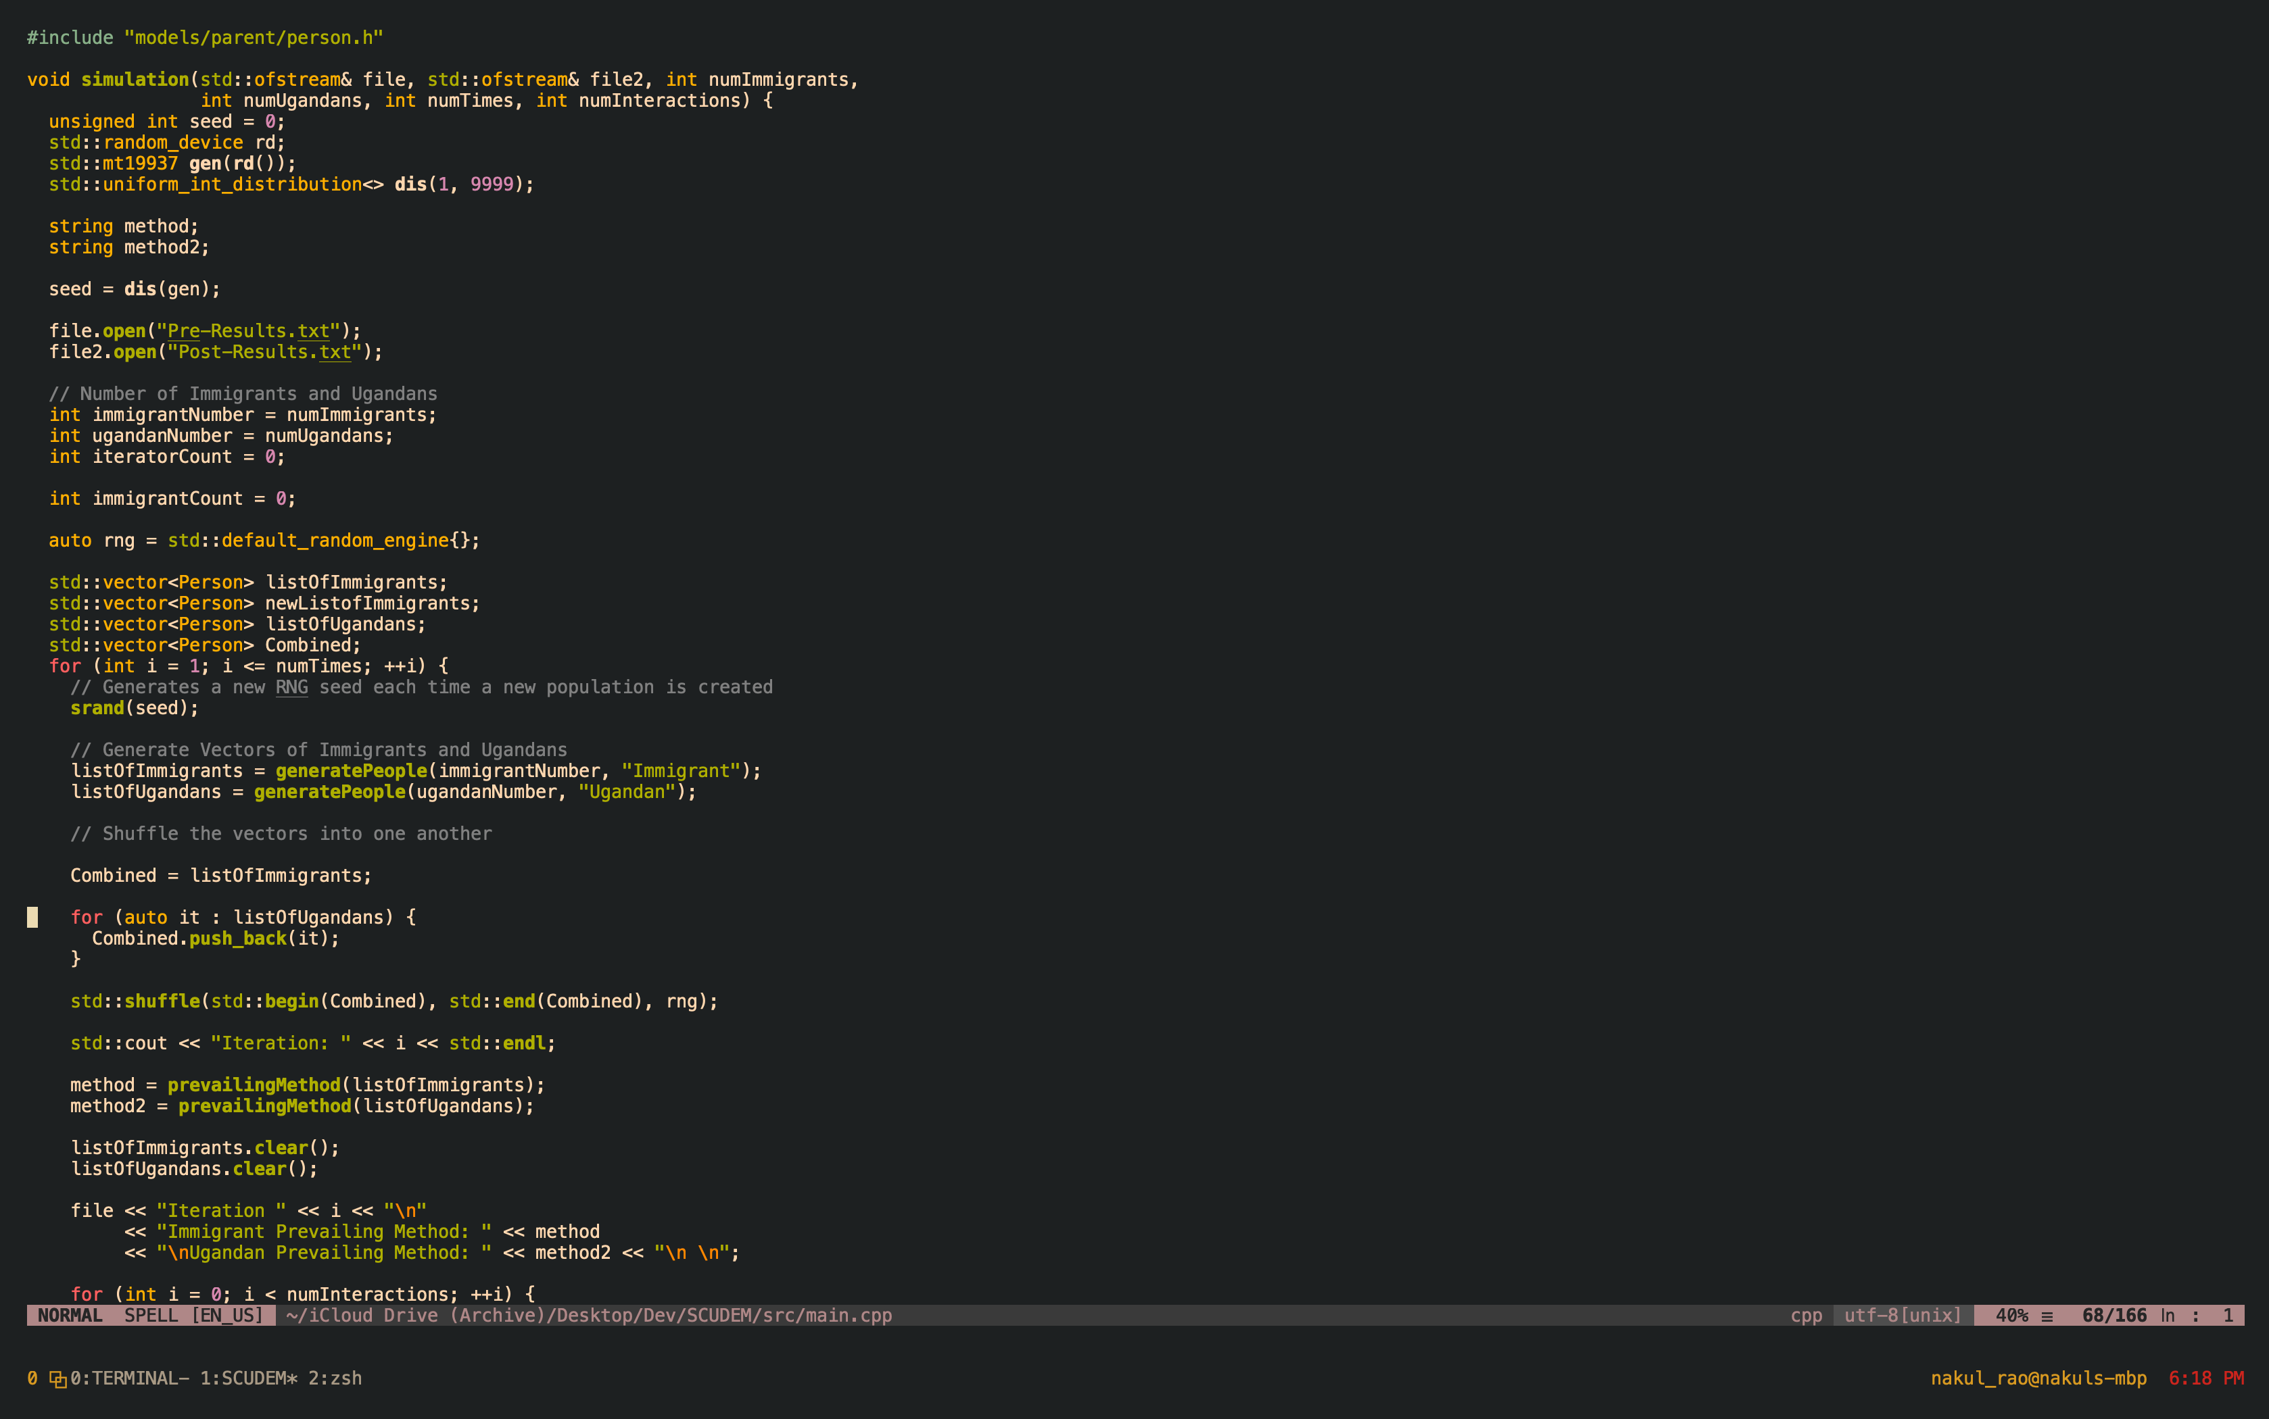
SOLUTION STRATEGY
SIMULATION
C++ PROGRAM
NeoVim, Alacritty, TMUX, CMAKE, CCLS
Github: https://github.com/Nakul-27/SCUDEM-Populations
RANDOM GENERATION
INTERACTIONS
FITNESS
CHANGE METHOD

Slide 4
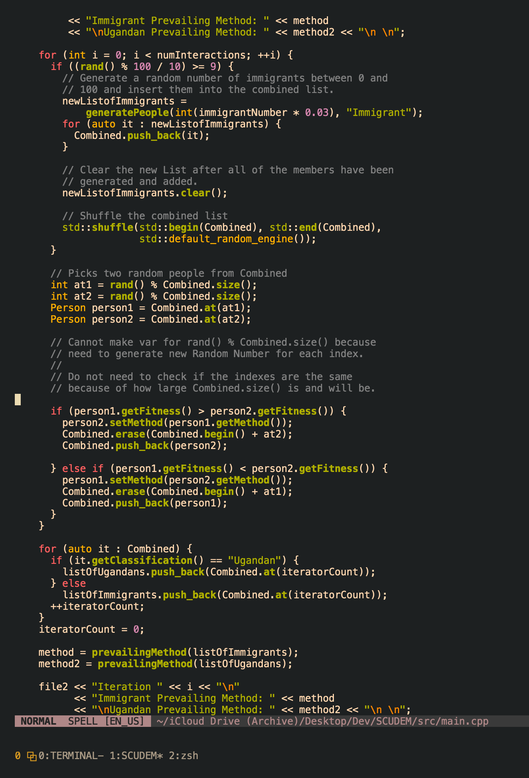
Variables
Person Class
Characteristics
Simulation Function
Runs the Whole Thing
Get Technique Function
Generate Technique
Output Files
Pre-Results.txt
Post-Results.txt

Slide 5
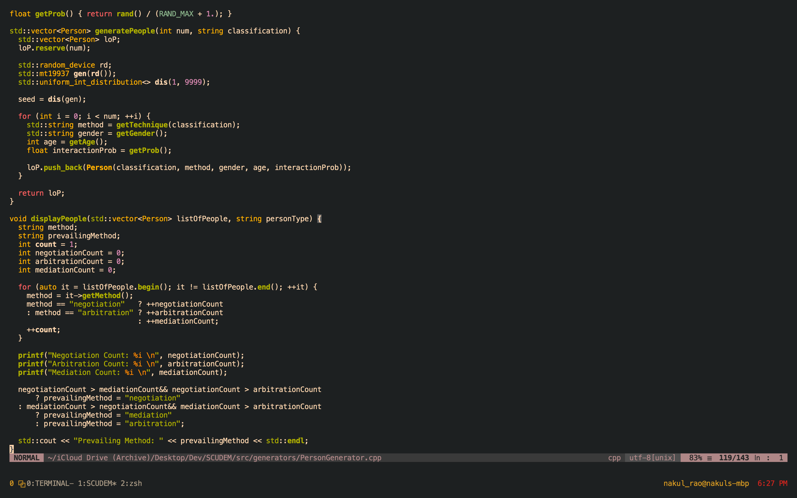
Assumptions and Limitations
GENETIC/EVOLUTIONARY MODEL
INTERACTION BETWEEN TWO PEOPLE
PATRIARCHAL INFLUENCE
METHOD LEANINGS BY GROUP
TECHNOLOGICAL RESTRICTIONS
INTRODUCTION OF NEW IMMIGRANTS

Slide 6
Ways to extend the project
INCREASE NUMBER OF INTERACTIONS/RUN MORE SIMULATIONS
INCREASE NUMBER OF INFLUENTIAL CHARACTERISTICS
IMPROVE SIMULATION FUNCTION
METHODS OF CHANGING PREFERRED TECHNIQUE OF MEDIATION
MORE CONCRETE METHOD OF DETERMINING WHO IS INTERACTING WITH EACHOTHER.

Slide 7
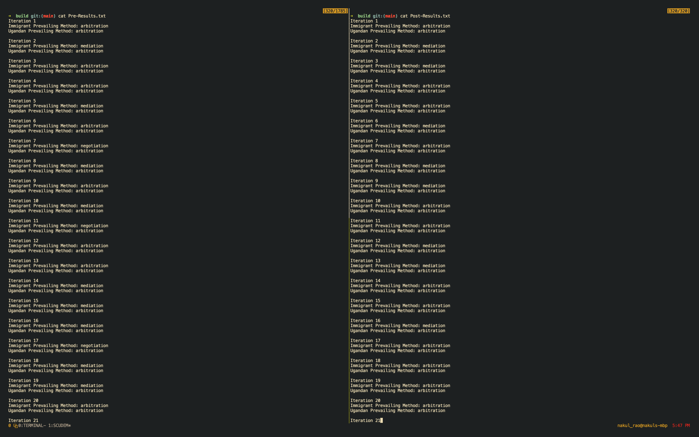
CONCLUSION

